Slide 1
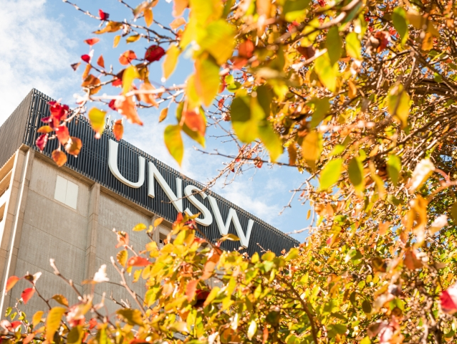
Management Lab
Stocktake
Chloe Nguyen
School of Information Systems and Technology Management
UNSW Business School
chloe.nguyen@unsw.edu.au

Slide 2
Thesis Focus
Research Objectives
How can Architecture, Design, and Engineering (ADE) organisations develop digital capabilities and information systems for efficient delivery and overcome challenges in digital transformation?
Aspects: Past, present, future
Methodology:
Action design research, case study

Slide 3
Projects/Studies
Aspect | Aim | Specification | Methodology | Progress
 |  |  |  | Preparation | Literature review | Solution | Validation/ Experiment
Past | Examining the evolution/ implementation journey of digital technologies and their impact of the business | TBC | Case study | Looking for a case | Pending
Present | Designing and developing technologies for digital transformation | Designing a carbon management system (estimation) for the lifecycle assessment - Architectus | Action design research | In the process of lodging an ethics application | Reading about carbon management standards | Pending
Future | Identifying and predicting the future/foresight for potential impact | Proposing the Design Foresight framework for future-ready design science research | Methodological proposal - Case study | Done | Working on the first round of comments |  | Pending

Slide 4
Zoom In
Study 3: Future Aspect
Title:
Incorporating Futures Thinking in Design Science Research: A Design Foresight Approach
Research question:
How to design future-ready systems?
Approach:
Leveraging the concepts of design and foresight in futures studies (Fu & Xia, 2023), this article proposes the Design Foresight framework for designing future-ready artifacts using design science research.

Slide 5
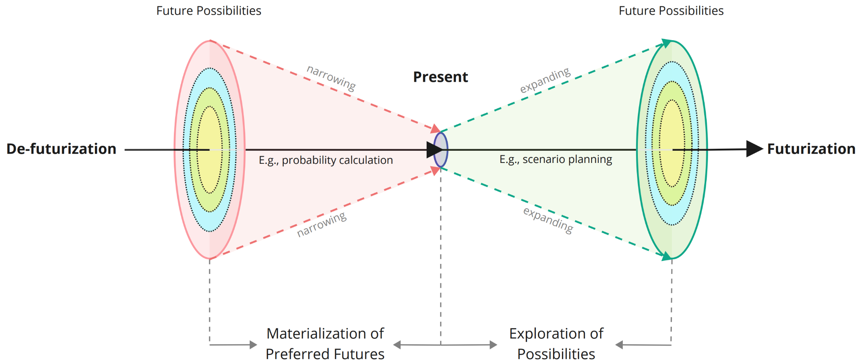
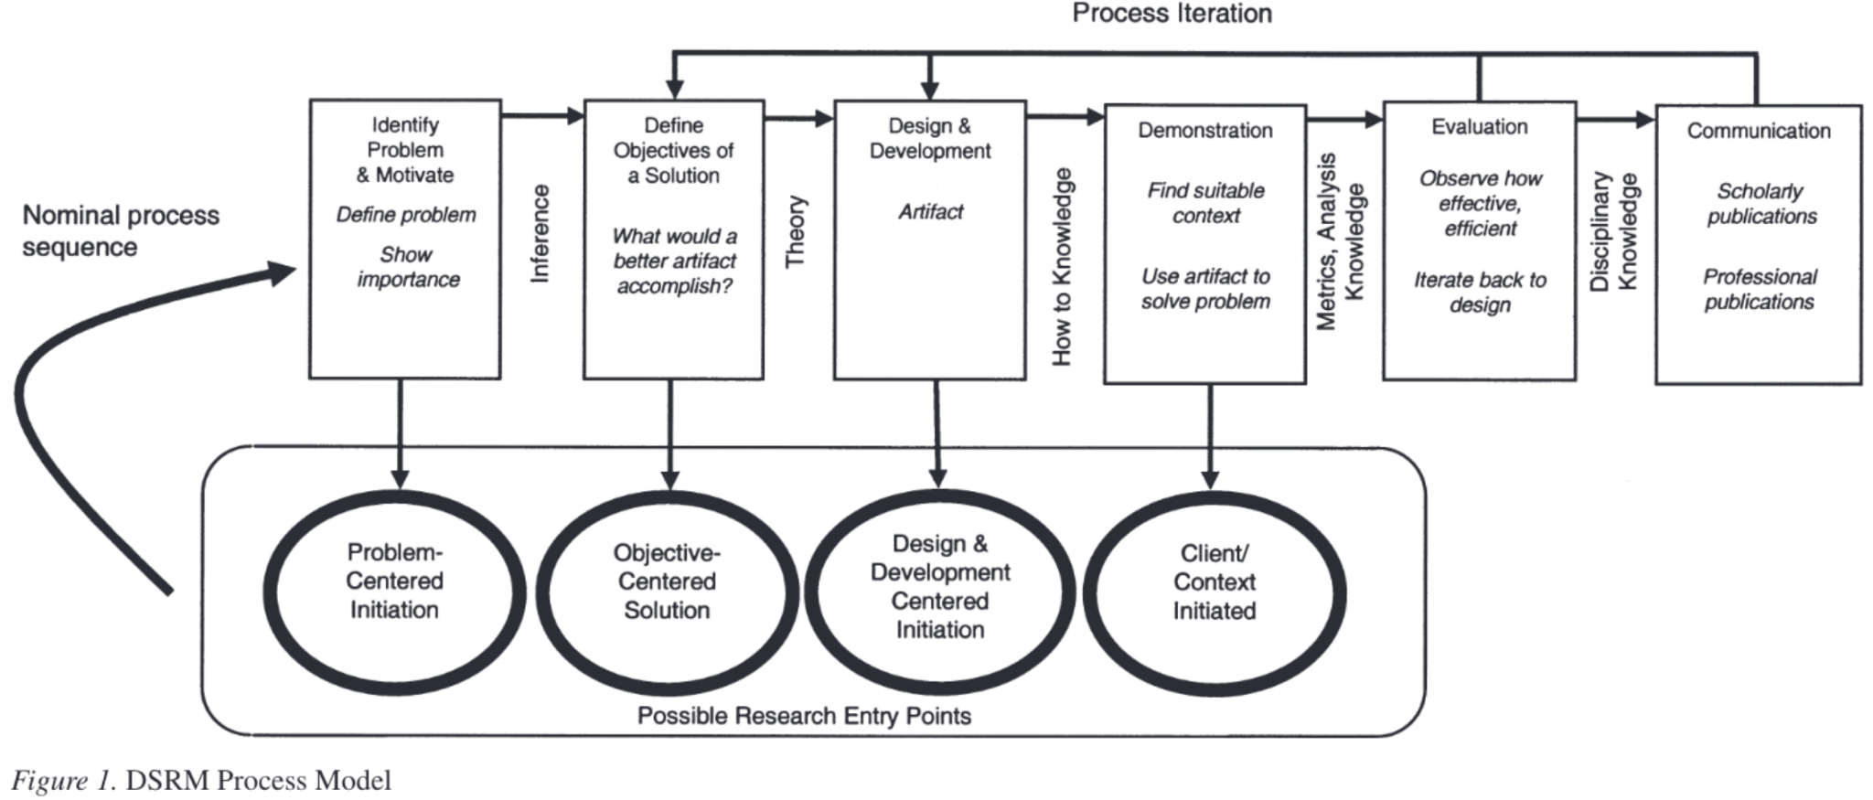
Zoom In
Study 3: Future Aspect
Foundation
Foresight in futures study
Design science research
Adapted from Fu & Xia, 2023
Peffers et al., 2007

Slide 6
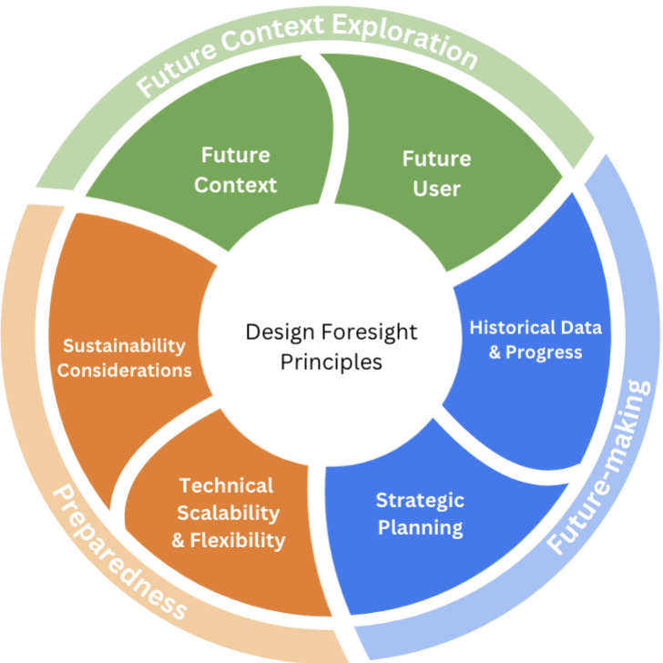
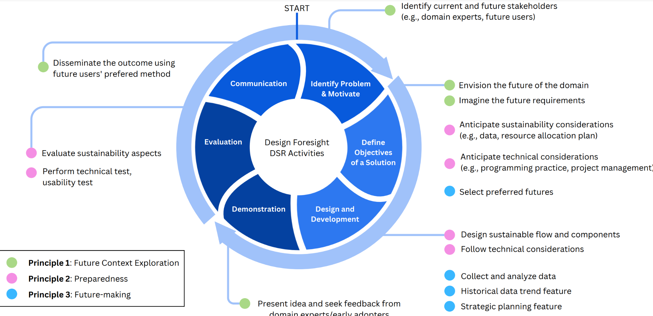
Zoom In
Study 3: Future Aspect
Framework:

Slide 7
Next Steps
Aspect | Aim | Specification | Methodology | Progress
 |  |  |  | Preparation | Literature review | Solution | Validation/ Experiment
Past Transition Design | Examining the evolution/ implementation journey of digital technologies and their impact of the business Difficulties, challenges before OneClickLCA Timeline: Before + Early stage | TBC | Case study | Possibly Archirectus As the first step for ADR - Present aspect study | Pending
Present | Designing and developing technologies for digital transformation | Designing a carbon management system (estimation) for the lifecycle assessment - Architectus | Action design research | Having the ethics application approved | Drafting the literature review section | Pending
Future Design Foresignt | Identifying and predicting the future/foresight for potential impact | Proposing the Design Foresight framework for future-ready design science research | Methodological proposal - Case study | Done | Reviewing for the 2nd round of comments |  | Pending
Next week:
Submit the ethics application for review (expected response in 01 week)
Send 2nd version of Study 3
October:
Prepare for Pre-Confirmation (17 Oct)
Prepare for Symposium (29 Oct)
Courses: COMM8003 - COMM8103

Slide 8
Management Lab
Stocktake
Chloe Nguyen
School of Information Systems and Technology Management
UNSW Business School
chloe.nguyen@unsw.edu.au

Slide 9
Reference
Fu, Z., & Xia, Q. (in press 2023). Design foresight: A design approach that marries the futurization and de-futurization. Journal of Futures Studies
Peffers, K., Tuunanen, T., Rothenberger, M. A., & Chatterjee, S. (2007). A design science research methodology for information systems research.
Journal of management information systems, 24 (3), 45–77.

